Slide 1
Form Validation
Validating Form Data In The Browser | Validating Form Input With JS | Validating Form Data Upon Submission | Validating Each Field As Data Is Entered | HTML Form Validation
Notes:
Welcome to our lecture on form validation. In this lecture we will go through Validating Form Data In The Browser, Validating Form Input With JS, Validating Form Data Upon Submission, Validating Each Field As Data Is Entered, and HTML Form Validation. Let’s start the video lecture.

Slide 2
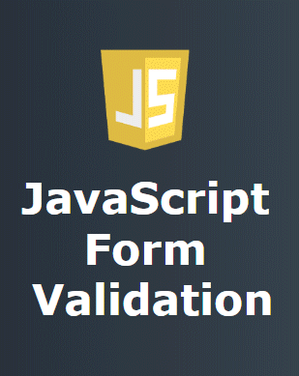
Validating Form Data In The Browser
Ensures Data Integrity: Enforces correct formats like 16-digit credit cards, valid dates, and U.S. state names.
Enhances User Experience: Browser validation flags errors instantly, reducing reliance on server responses.
Implementation: Uses JavaScript to validate inputs during entry or before form submission.
Notes:
Today, we are going to talk about an essential aspect of web development—form validation in the browser. When users fill out forms, ensuring the accuracy of their input is crucial. This not only maintains data integrity but also improves the user experience. Browser validation, especially using JavaScript, helps us catch errors instantly before data is submitted to a server. Let’s explore how this works.

Slide 3
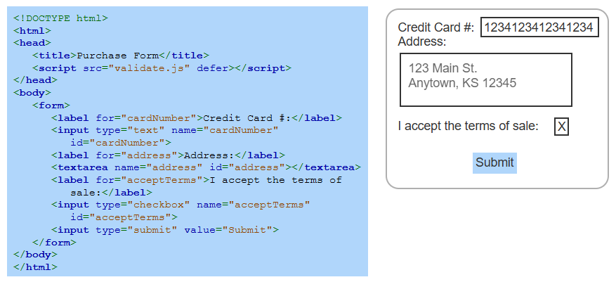
Example
Notes:
Now, let us look at an example of a simple form. On the left, we see the HTML code that creates a basic purchase form. It includes fields for a credit card number, an address, and a checkbox for accepting terms. On the right, we see how this form appears in the browser. Without validation, users can enter incorrect data. Next, we will explore how JavaScript can enforce proper input formats.

Slide 4
Validating form input with JavaScript
Value Attribute: Stores user-entered text in an HTML input element.
Validation Methods:
Check length using .length
Compare exact value with ===
Find specific text using indexOf()
Verify numbers with isNaN()
Match patterns using match() with regex
Notes:
Now that we have seen a basic form, let us explore how JavaScript helps validate user input. The value attribute stores what the user enters in a field. To validate input, we can use different methods. We can check the length, compare exact values, search for specific text, verify numbers, or match patterns using regular expressions. These methods help ensure that users enter correct and expected data.

Slide 5
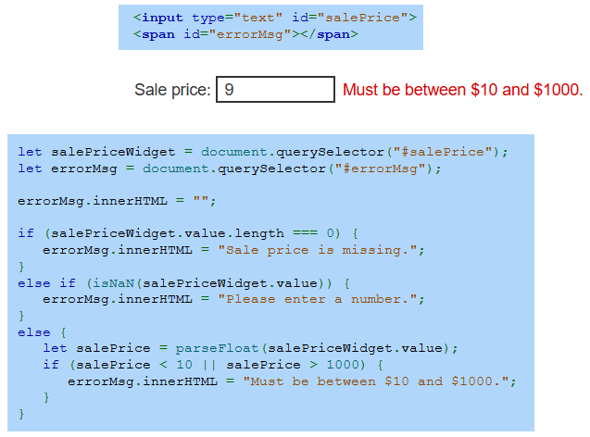
Example
Notes:
Let us now look at an example of JavaScript form validation in action. Here, we have an input field for a sale price, and JavaScript checks if the entered value is valid. If the field is empty, it shows an error. If the input is not a number, another message appears. Finally, if the number is outside the valid range of 10 to 1000, it displays a warning. This ensures only acceptable values are submitted.

Slide 6
Validating form data upon submission
Register Submit Handler: Attach a validation function to the form's submit event.
Inspect Input Fields: Use DOM elements and attributes to check user input.
Prevent Invalid Submission: Call preventDefault() to stop form submission if validation fails.
Notes:
So far, we have looked at validating user input while typing. Now, let us focus on validation when submitting a form. First, we register a submit handler that runs a validation function. Then, we inspect the input fields using DOM elements to check for errors. If the validation fails, we call preventDefault to stop the form from submitting. This ensures that only valid data is sent to the server.

Slide 7
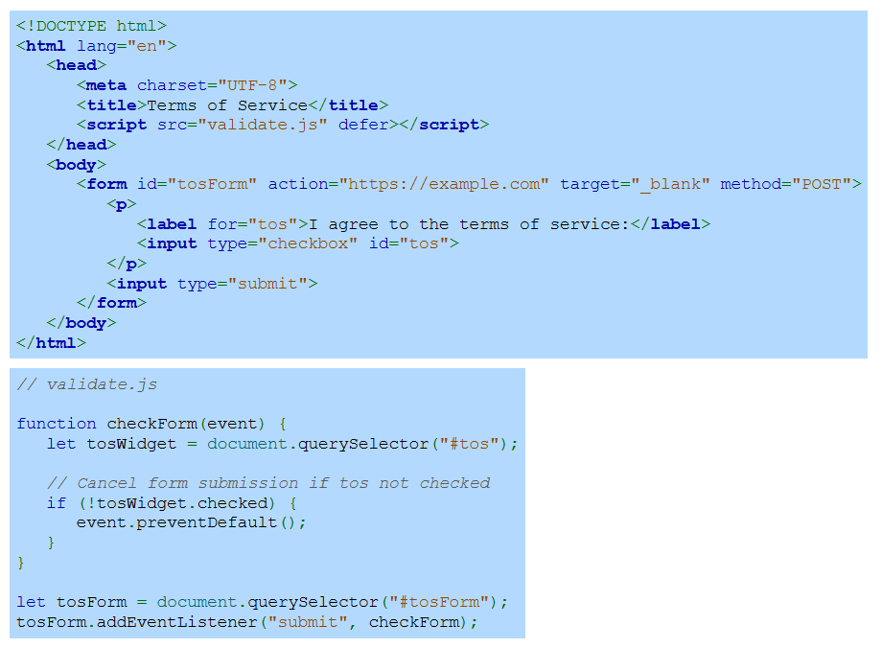
Example
Notes:
Here is an example of validating form submission. The form includes a checkbox that users must check to agree to the terms of service before submitting. The JavaScript function listens for the submit event and checks if the box is checked. If it is not, preventDefault stops the submission. This ensures users cannot proceed without agreeing, enforcing necessary conditions before data is sent.

Slide 8
Validating each field as data is entered
Register Input Handlers: Attach event handlers to fields that need validation.
Track Field Validity: Use global variables, initially set to false, to monitor input validity.
Update Validation Status: Modify global variables within the field’s event handler as needed.
Validate on Submit: Ensure all global variables are true before allowing form submission.
Prevent Invalid Submission: Call preventDefault() if any field remains invalid.
Notes:
Now, let us look at validating each field as data is entered. We start by registering input handlers to track changes in form fields. Using global variables, we monitor validity and update them when inputs meet the required conditions. On submission, we check if all fields are valid. If any field is still incorrect, preventDefault stops the form from submitting, ensuring only correct data is processed.

Slide 9
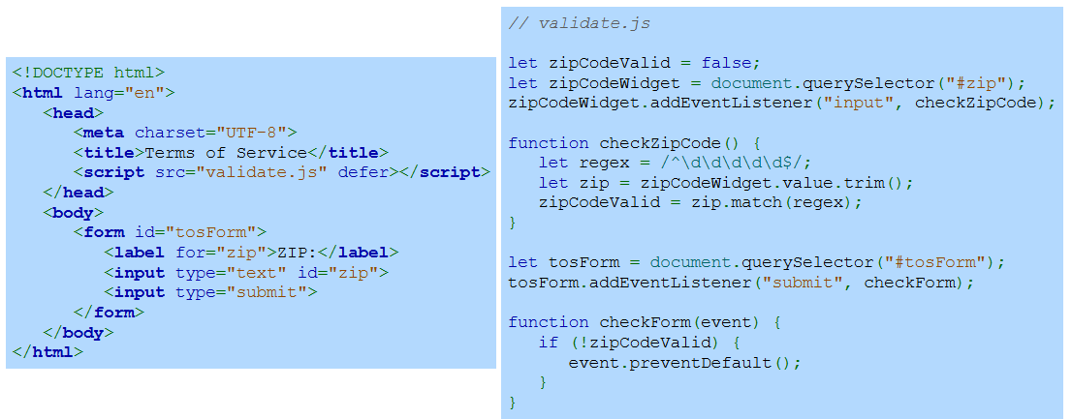
Example
Notes:
This example shows how to validate a ZIP code field as the user types. The JavaScript script listens for input changes and checks if the value matches a valid pattern. A global variable tracks whether the ZIP code is valid. When the form is submitted, the script ensures the field meets the correct format. If not, preventDefault stops submission, ensuring only properly formatted data is accepted.

Slide 10
Using HTML form validation
Built-in Validation: Some inputs (e.g., date, color) ensure valid values via browser pop-ups.
Attribute-Based Validation: No JavaScript needed for basic checks:
required – Ensures input before submission.
max / min – Sets value range (e.g., date, number).
maxlength / minlength – Defines input length limits.
pattern – Uses regex for validation.
title – Provides input guidance with pattern.
Notes:
Now, let us look at HTML form validation, which can handle basic checks without JavaScript. Built-in validation applies to certain input types like dates and colors. For more control, we use attributes. The required attribute ensures input is not empty. Max and min define value ranges. Maxlength and minlength control input length. Pattern uses regex for validation, and title provides user guidance.

Slide 11
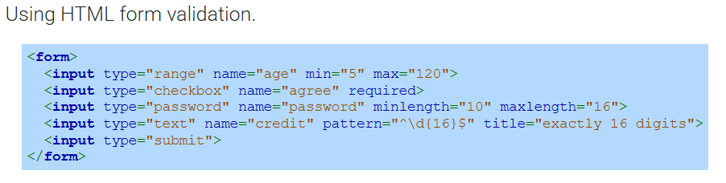
Example
Notes:
This example demonstrates HTML form validation in action. The age input uses a range with a minimum of 5 and a maximum of 120. The checkbox requires users to agree before submission. The password field has min length and max length attributes to enforce length restrictions. The credit card input uses a pattern to allow exactly 16 digits, with a title providing user guidance. These validations work without JavaScript. Thanks for watching the lecture.

